Slide 1
How Does Brain Based Visual Impairment Impact Adults Differently from Children?
Valery Kircher
COMS/TVI/CVI Certified/Doctoral Candidate

Slide 2
Today’s Agenda
Blindness and Low Vision
Terminology & Scenarios
Laws Related to Individuals with a Disability
Children and Adults with Brain Based Visual Impairments: Supports

Slide 3

Blindness and Low Vision

Slide 4
When low vision is due to an eye disease, injury or condition it typically results in reduced visual acuity, field loss, and diminished contrast sensitivity.¹⁵ This is referred to as ocular visual impairment.
When a visual impairment damage originates in the brain there may be alterations to visual attention, how visual information is interpreted and how it is integrated with other sensory inputs. ¹⁵ This is referred to as a brain-based visual impairment.

Slide 5
Definitions: CVI in Children
The National Institute of Health (NIH) recently defined CVI with a five-part definition (Chang, M.Y., et al., 2024, p.1360). ⁴
CVI encompasses a spectrum of visual impairments caused by an underlying brain abnormality that affects the development of visual processing pathways and is characterized by deficits in visual function and functional vision.
The visual dysfunction in CVI is greater than expected by any comorbid ocular conditions alone.
The visual dysfunction in CVI may manifest as lower-order or higher-order afferent visual deficits, or both, leading to characteristic behaviors in affected individuals.
Although CVI may be co-morbid with other neurodevelopmental disorders, CVI is not primarily a disorder of language, learning, or social communication.
The underlying neurologic insult of the developing brain may go unrecognized or undiagnosed until later in life

Slide 6
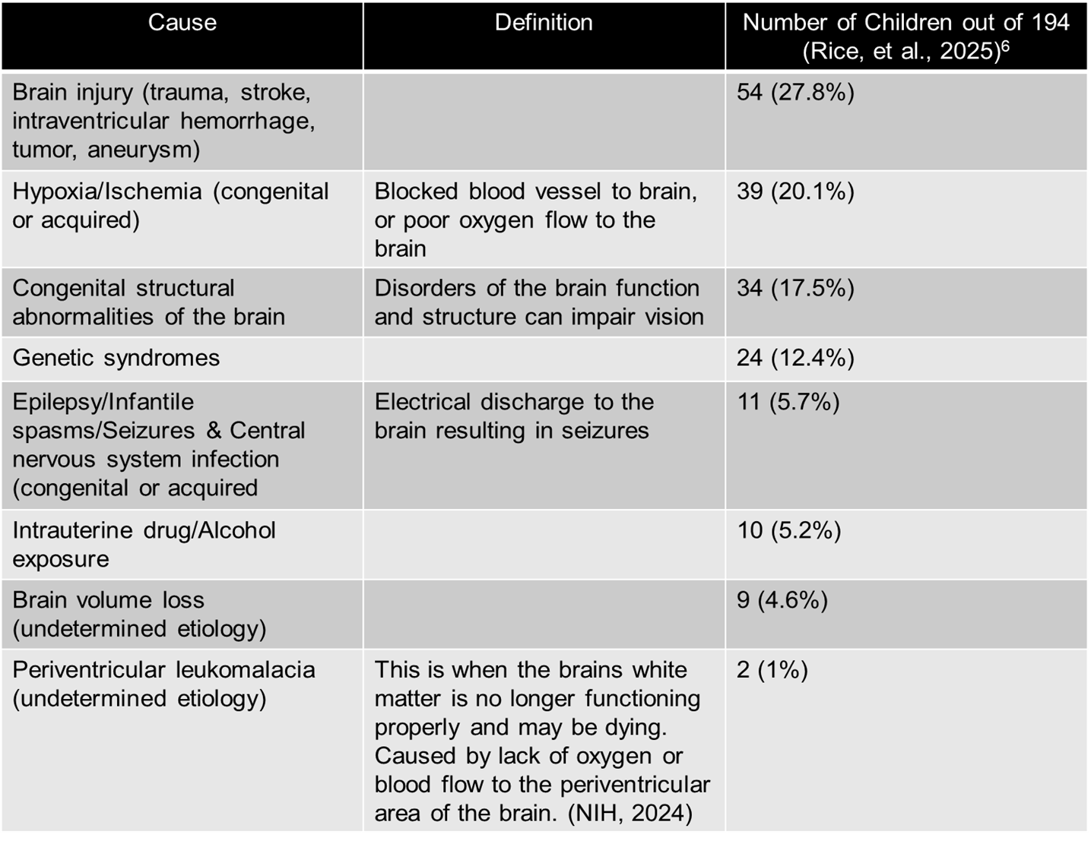
Causes of Brain Based Visual Impairment in a Child

Slide 7
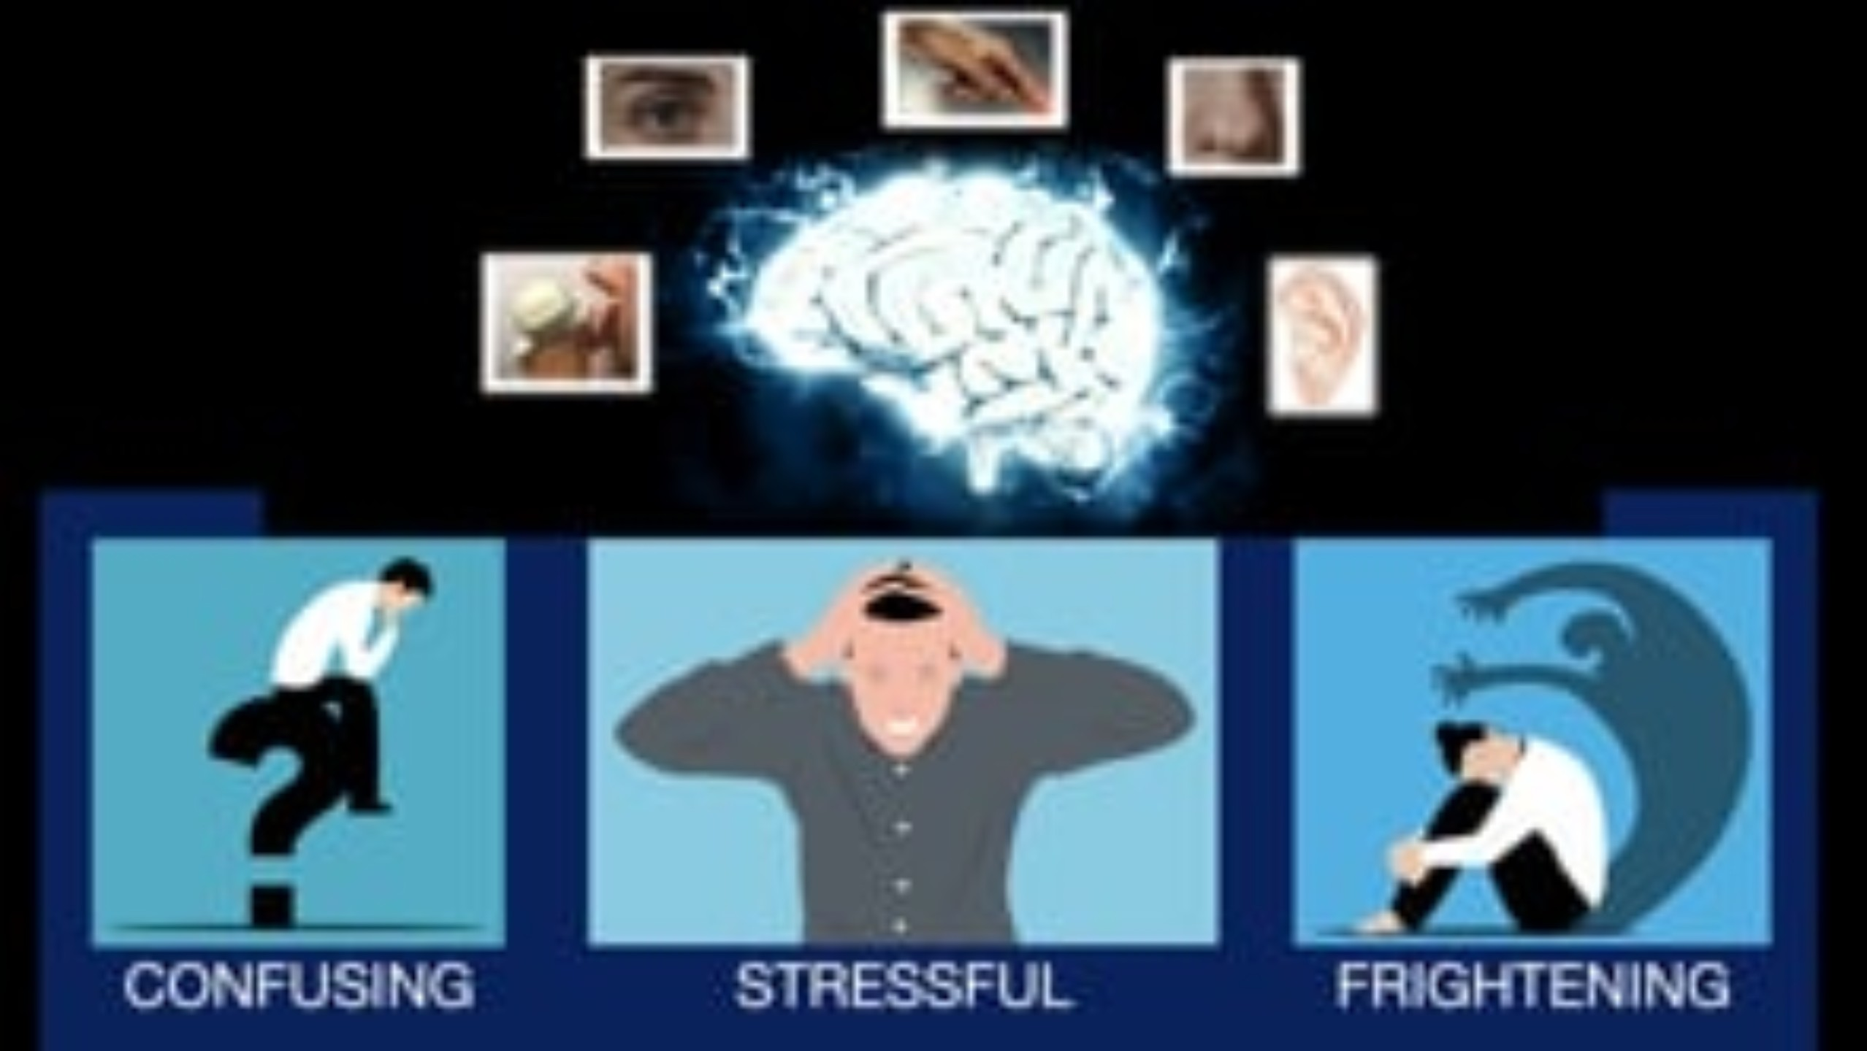

Slide 8
Posterior Cortical Atrophy (PCA)^{14,16}
A neurodegenerative disease with the prominence of simultanagnosia. However optic ataxia and ocular apraxia may also be present.
Syndrome leads to Alzheimer's disease in adults, often younger than 65 years old.
Often visual spatial dysfunction is the first sign of PCA
Often begins with the higher order visual dysfunctions
Could also be associated with Lewy body pathology with Alzheimer's

Slide 9
PCA – three must be present for diagnosis¹⁶
Space perception deficit
Simultanagnosia
Object perception deficit
Constructional dyspraxia
Environmental agnosia
Oculomotor apraxia
Dressing apraxia
Optic ataxia
Alexia, Left/right disorientation
Acalculia
Limb apraxia (not limb-kinetic)
Apperceptive prosopagnosia
Agraphia
Homonymous visual field defect
Finger agnosia

Slide 10
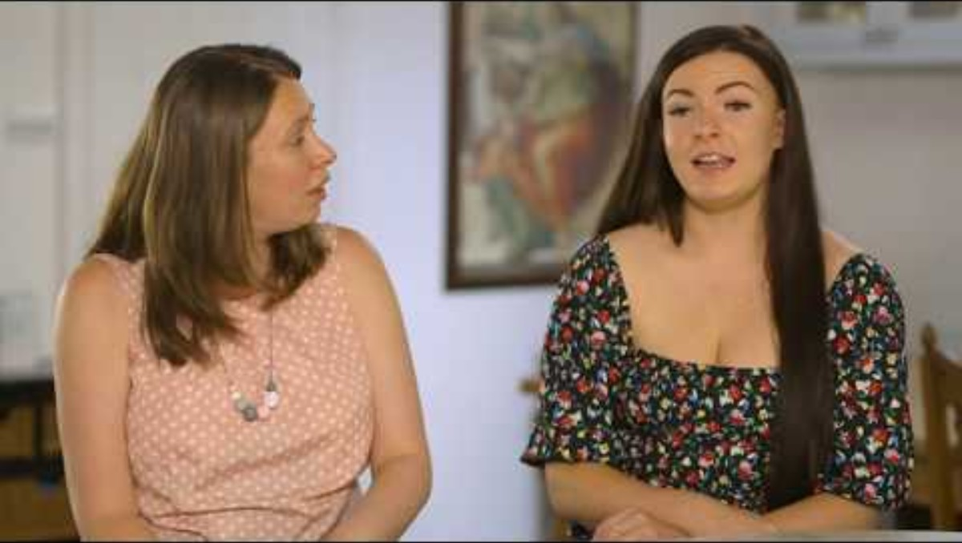

Slide 11
Some of the causes of brain based visual impairments in adults
Stroke¹
Brain tumors
Cerebral Visual Impairment (CVI)⁵
Brain injury
Heart related causes: encephalopathies, angiography, cardiac surgery, preeclampsia²
Neurodegenerative diseases (NDD)³
Alzheimer’s disease
Dementia with Lewy bodies
Parkinson’s dementia
Corticobasal degeneration
Creutzfeldt–Jakob disease

Slide 12
SYNDROME^{7,8} | FEATURES | AREA OF BRAIN IMPACTED | CAUSE
Balint syndrome | Simultanagnosia, integrative agnosia, Oculomotor apraxia, Optic ataxia (inability to move a hand to specific objects) | Biparietal syndrome of attention and oculomotor mechanisms | Degeneration and rarely stroke
Prosopagnosia | Inability to recognize faces | Right hemisphere temporooccipital mechanism | Stroke, or congenital
Visual agnosia | Failure to identify objects with otherwise good vision and nonvisual semantic cognition | Visual-temporal impairment RR>L | Stroke, carbon monoxide, and anoxia degenerative disease
Posterior Cortical Atrophy (PCA) syndrome- adult exhibits 3 of the following→ | Space perception deficit, Simultanagnosia, Object perception deficit, Constructional dyspraxia, Environmental agnosia, Oculomotor apraxia, Dressing apraxia, Optic ataxia, Alexia, Left/right disorientation, Acalculia, Limb apraxia (not limb-kinetic), Appercepive prosopagnosia, Agraphia, Homonymous visual field defect, Finger agnosia | Alzheimer's is most frequent cause, over 65 is more common | Damage to cerebral cortex
Riddoch syndrome | Inability to see static images, only moving objects | Back of the brain in the V5 area | Trauma, stroke, tumor
Akinetopsia | Inability to see objects that are in motion. | Central area of the temporal lobe | Brain injuries, certain medications, Alzheimer's

Slide 13
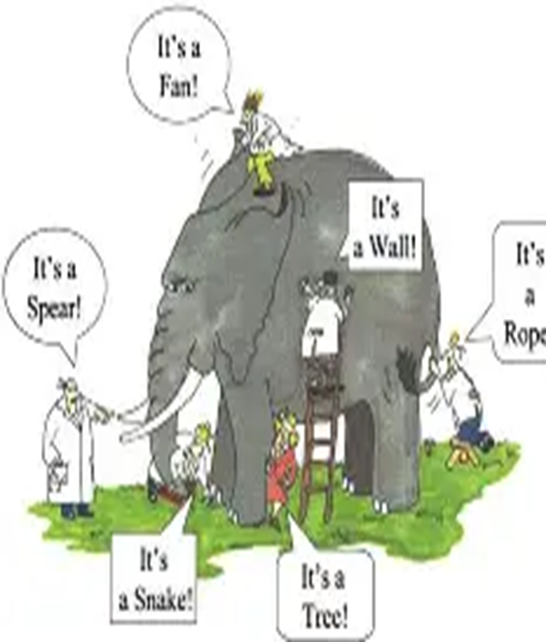
Terminology & Scenarios

Slide 14
Terms Apply to Both Adults and Children
It is important to note that these terms may overlap and may be intertwined in both children and adults with brain based visual impairment.

Slide 15
Related to Children
Dorsal Stream
Ventral Stream
Akinetopsia/Dyskinetopsia
Topographic Agnosia
Auditory Processing Disorder

Slide 16
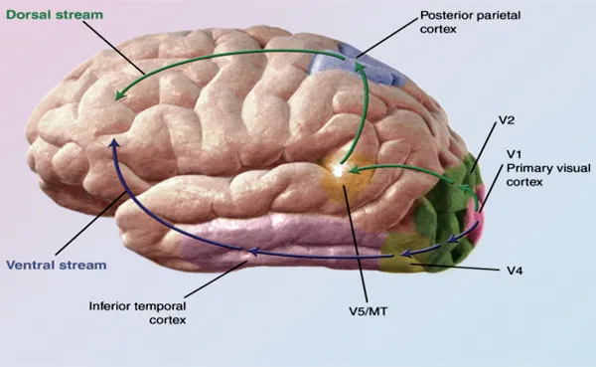
Human Brain
Essay // Biopsychology: The Temporal Lobes: Vision, Sound & Awareness | dpurb . com

Slide 17

Two Visual Streams Model : Dorsal
Dorsal visual stream-posterior parietal lobe and occipital lobe
Motion perception difficulties
Navigating through three-dimensional spaces
Difficulty with visual guidance of movement
Difficulty with visually (and auditorily) complex environments

Slide 18

Two Visual Streams Model : Ventral
Ventral visual stream-temporal lobe and occipital lobe
Difficulty with color and hue perception
Difficulty with shape, object, symbol recognition
Difficulty with letter, word and sound identification
Face recognition and facial expression recognition
Topographic agnosia

Slide 19

Perceiving Motion
Akinetopsia- Anything that moves is not seen at all
Dyskinetopsia- things that move quickly are not seen clearly
As a teacher, O&M specialist, or other professional what could you do to help the individual you are working with?
SLOW THINGS DOWN
This Photo by Unknown Author is licensed under CC BY

Slide 20
Topographic Agnosia¹⁷
This occurs when a child (or adult) is unable to travel a route – even ones that are familiar – because of an inability to recollect or remember a route- but this is NOT due to memory difficulties BUT instead is due to right temporal lobe processing issues

Slide 21
Scenario
You are an O&M specialist orienting a student to their new school, the student, as part of their diagnosis of CVI has topographic agnosia. How can you assist them in learning their way around their middle school?
Talk to your neighbor to determine strategies that you as the teacher could use
Take time to learn the route, repeat the route more often, possibly have student learn routes when there are few people in the building

Slide 22
Auditory Processing Disorder or APD¹⁸
APD refers to “impairments in processing auditory stimuli due to central nervous system abnormalities despite intact peripheral auditory structures” (Konopka et al., 2024, p. 736).

Slide 23
Scenario
You have a student with both APD and CVI and as a TVI you are expected to assist with accommodations in the student's college prep classes this year. The IEP meeting is coming up – who could you go to for assistance?
Talk to your neighbor to determine strategies that you as the teacher could use

Slide 24
Related to Adults
Simultanagnosia
Apraxia
Prosopagnosia
Agraphia
Optic ataxia

Slide 25
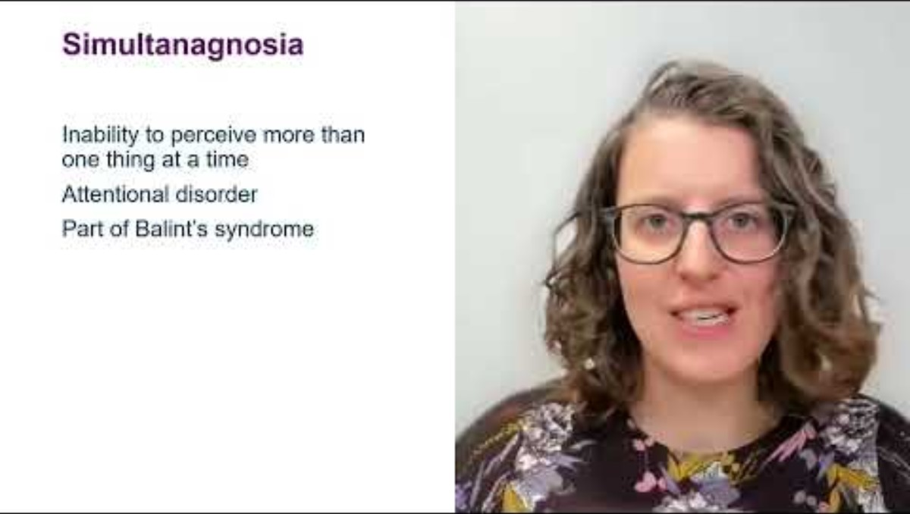

Slide 26
Simultanagnosia
Simultanagnosia - a person may be able to identify a single object but may not be able to “integrate into a single representation regardless of size” and in severe cases the person may only be able to identify parts of an object (Veronelli et al., 2025
Adults with this may be able to list out letters but not read the word
Adults with this may be able to count dots on a paper only if there is a line connecting the dots

Slide 27
Scenario
Your client wants to learn to cook spaghetti and meatballs. You are the rehabilitation teacher coming over to instruct the individual on how to prepare this meal.
You have asked the individual to place all the cold ingredients on a shelf in the refrigerator.
However, this is a task that is difficult to complete for this individual who lives alone
Talk to your neighbor to determine strategies that you as the teacher could use

Slide 28
Apraxia²²
An inability of an individual to move their eyes towards an object which has been pointed out to the individual
This is an element of dorsal stream dysfunction (DSD)
This may be a “consequence of simultanagnosia rather than a distinct visual impairment” (St. Clair Tracy, et al., 2025).

Slide 29
Prosopagnosia¹⁹
Prosopagnosia, or the inability to identify faces or facial emotions, might also be defined on a perceptual level to interpret 3D structures which are viewed at different angles and has “mobile elements that introduce variations in shape during emotional expression and speech” (Barton et al., 2025, p. 331).
People with prosopagnosia must be able to see a face and have a visual memory of it. Often people with this diagnosis have an injury to the right temporal lobe specifically the fusiform gyrus where the memory of faces is stored.
Adults with this may also have difficulty with recognizing facial expressions.

Slide 30
Scenario
The individual you are working with as a O&M specialist had a stroke in the past, but she is now home from the rehabilitation center and has been back to work for several months.
The individual struggles in recognizing other people around her including coworkers.
As a teacher at a university this is problematic – though most of the classes she teaches are upper-level graduate classes with few students.
What accommodations would be helpful for her in her work?
Talk to your neighbor to determine strategies that you as the teacher could use

Slide 31
Agraphia²³
These are acquired disorders of spelling or writing caused by neurological damage
Often accompanied by reading disorders (alexia) and spoken disorder (aphasia)
One common cause of agraphia is a stroke
Other causes are Alzheimer's disease, multiple sclerosis, primary aphasia
Detecting this may be done by observing post trauma writing as compared to pre trauma writing samples- seeing a decline in writing may be an indication of a decline for example in Alzheimer's disease

Slide 32
Optic Ataxia²⁰
Optic ataxia is another word for impaired visually guided movement
The person with this may experience a difficulty measuring distance and have difficulty with depth perception
The person may have difficulty reaching for objects accurately and may miss objects or knock objects over
The person may have difficulty writing or eating
The person may have a meltdown, or a fight or flight reaction, may feel clumsy, embarrassed, angry, frustrated, or confused
Busy areas like a grocery store, airport, or other busy places with lots of moving objects or people reaching for items across them (think of the produce section of a grocery store) may bring on the above feelings or reactions

Slide 33


Slide 34
Scenario
Take the paper with the red circle, turn to your neighbor
Hold the paper about 12” from your neighbor
Ask your neighbor to place their finger or pen inside the circle
Then switch so that both of you get to try this activity
A person with optic ataxia may take longer to do this activity
The person may move the pen or finger along a surface
They may mark other parts of the paper and not inside the red circle

Slide 35

Laws Related to Individuals with a Disability

Slide 36
Federal Laws for All Individuals with a Disability²¹
Telecommunications Act of 1996
amended in 1996 ensuring that communication equipment and services are accessible
Americans with Disabilities Act of 1990
prohibits discrimination based on disability in employment, State and local government, public accommodations, commercial facilities, transportation, and telecommunications.
Air Carrier Access Act of 1986
prohibits discrimination in air transportation by domestic and foreign air carriers against qualified individuals with physical or mental impairments.
Voting Accessibility for the Elderly and Handicapped Act of 1984
Requires polling places to be accessible for individuals with a disability for FEDERAL elections
If no accessible place is available, then an alternate means of casting a ballot on the day of the election must be provided
The law also requires states to make registration and voting aids available for individuals with a disability or who are elderly (such as coming to your car to allow you to cast your ballot from your car)

Slide 37
Federal Laws for All Individuals with a Disability²¹
National Voter Registration Act of 1993 also known as the Motor Voter Act
Requires all state offices (including DBVI) that provide services to individuals with a disability to provide applicants with a voter registration form, assistance to complete the forms and to transmit completed forms to the appropriate state officials
Rehabilitation Act of 1973 and amended
prohibits discrimination based on a disability in programs conducted by Federal agencies, in programs receiving Federal financial assistance, in Federal employment, and in the employment practices of Federal contractors.
Including Section:
501 –affirmative action & nondiscrimination in employment at federal agencies or executive branch
503- affirmative action & nondiscrimination by federal contractors and subcontractors
504- broadly this protects individuals with a disability from discrimination by any program or activity that receives federal funds and includes extensive information about reasonable accommodations, accessibility and effective communication
508- requires electronic communication and information technology used by federal government to be accessible by individuals with a disability
Fair Housing Act of 1988
requires owners to make reasonable exceptions (for example guide dogs for individuals who are blind) to housing, as well as reasonable access-related modifications to housing for individuals with disabilities

Slide 38
IDEA and Children with CVI
Part C of the Individuals with Disabilities Education Act (IDEA) ensures children 0-3 yrs receive services through states Early Intervention programs including assessment and intervention to prepare children for future education
Children with CVI are often eligible and may receive “developmental enrichment, coordination, health, and social services” until they reach the age of 3 and can enter preschool
Part B of IDEA includes Memorandums to State Directors of Special Education, Office of Special Education and Rehabilitative Service (OSEP) ¹¹
2 step approach: Individual Education Program (IEP) determines whether child has a visual impairment and includes conditions including CVI. The condition must adversely impact the child's education performance

Slide 39
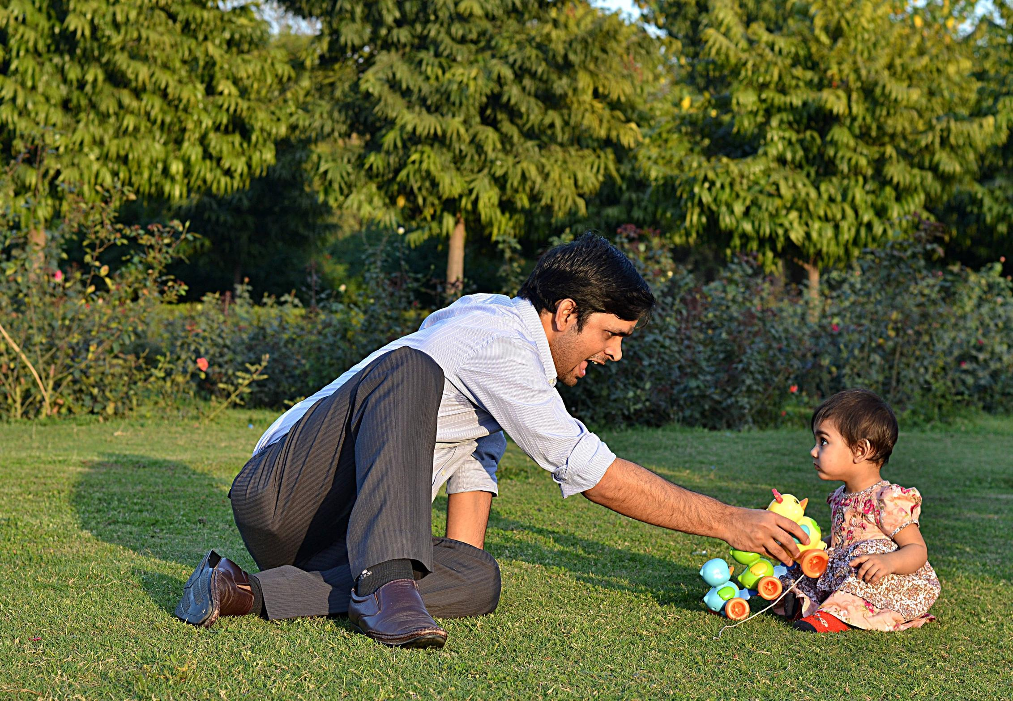
Children and Adults with Brain Based Visual Impairments: Supports
This Photo by Unknown Author is licensed under CC BY-SA

Slide 40
ADULTS ¹⁰ | CHILDREN ^{10, 4}
Lack of knowledge amongst medical providers on diagnosing brain based VI, including CVI | Children from marginalized groups may not receive the same care and screening opportunities
Lack of research on transitional services for young adults with CVI – plan early for transition services for teens with CVI | There is more awareness of CVI in children amongst educational professionals
VR, RT, O&M professionals may lack knowledge of CVI | NIH has taken up CVI and hopefully this will trickle down to pediatric ophthalmologist currently practicing

Slide 41
Supports for Children with CVI
Academics
O&M

Slide 42
Academics: Based on CVI Scotland’s Partnership Model²²
Preparation & Planning
TVI request materials ahead of time so they can be converted into a format the child can see more easily, or tactual format
Parents or guardians review material at home so that the child becomes familiar with it
Alternative methods of learning- the website provides an example of baking to learn measurement
Parents/guardians ensure child is well rested and comfortable and ready to learn

Slide 43
Academics: Based on CVI Scotland’s Partnership Model²²
Teaching
Ensure that the classroom teacher knows that switching from the speaker to a book to a screen to other classmates is very taxing and difficult and working on one of the above at a time is preferable
Radio language is language that is rich in descriptors which fills in the blanks of what you cannot see
Practice the following activity in a group of 2 people:
One person in the group will listen to the video with their eyes closed (if you are able to see the screen)
The other person will view the video with their functional vision and take notes if they desire
The person who viewed the video will explain to their partner what the video was all about
Their partner will then describe and fill in the blanks anything missed in the video
Now both partners listen to the example of a great video demonstrating RADIO LANGUAGE!

Slide 44
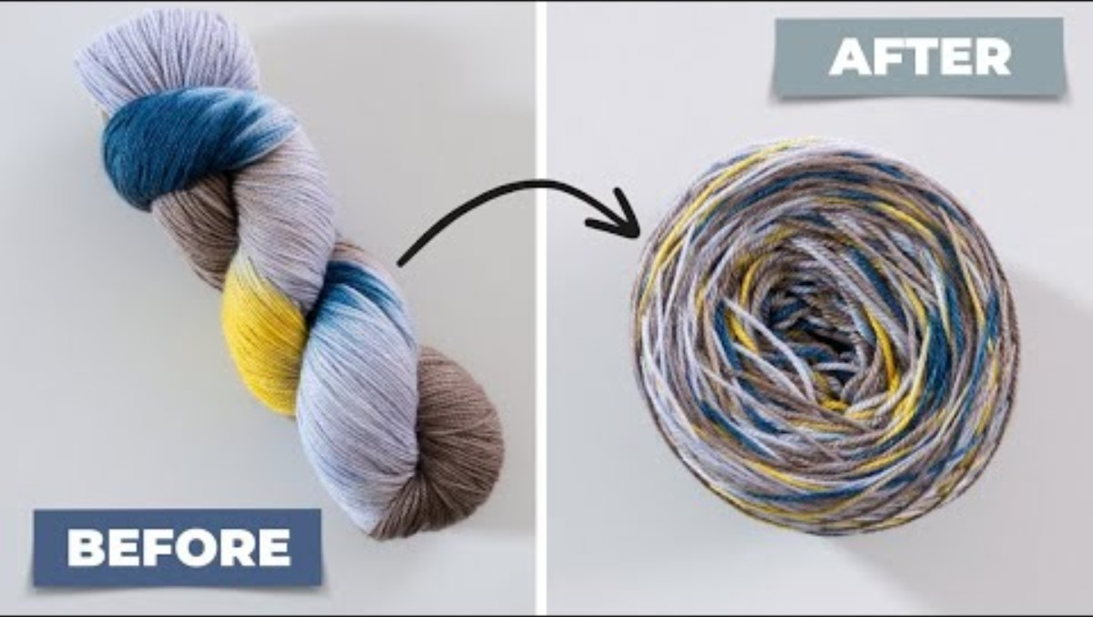
Example of What Radio Language is NOT

Slide 45

Example of What Radio Language IS

Slide 46
Academics: Based on CVI Scotland’s Partnership Model²²
Encouragement and Appreciation
Tell the child, teachers, parents/guardians that they are all going above and beyond for the child with the goal of helping the child to be successful
There is no perfect solution- this is looking for day to day improvements for the child
Remember it takes a village to raise and educate a child take the small wins where they come
Most important- JUST because you have met ONE child with CVI does NOT mean the next child with CVI will require the same accommodations and learning styles

Slide 47
O&M Supports
Assessment – ensure you are working with a TVI and using their assessments for students with CVI
Modifications to lessons- when you are providing instruction modify lessons as needed to help a student with CVI get the most out of lessons.
For example, if a student is unable to travel a route due to Topographic Agnosia create (with the student if appropriate) a book of landmarks, written instructions, or recorded instructions for a route that is familiar in a school building and then do this for an unfamiliar route
Create a simple rhyme or poem with the child to help remember a route- basically remembering a route in chunks – from the CVI Scotland website:
outside home is a red post box, walk towards the door with a fox, look for the window with curtains blue, the shop's next door, buy something new". And reverse it for the way home.

Slide 48
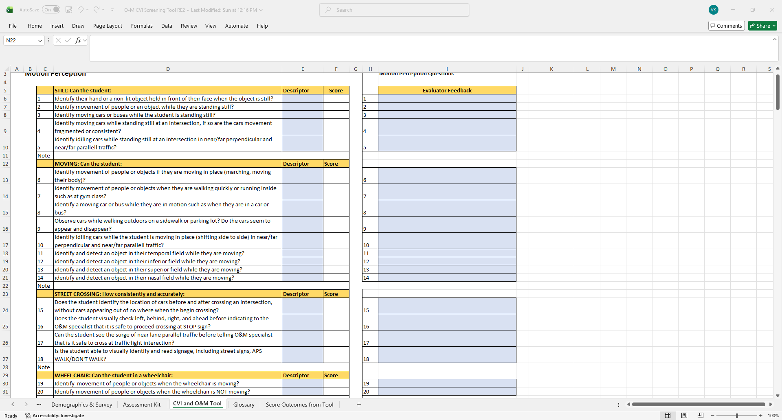
Assessment tool for O&M for Children with CVI

Slide 49
Supports for Adults with PCA or other Brain Based Visual Impairments
Assessments for adults
Activities of Daily Living (ADL)

Slide 50
BIVI-QI
Brain Injury Associated Visual Impairment Questionnaire (BIVI-IQ)
This assessment tool was developed to assess the impact a brain injury has on an associated visual impairment
Included in packet

Slide 51
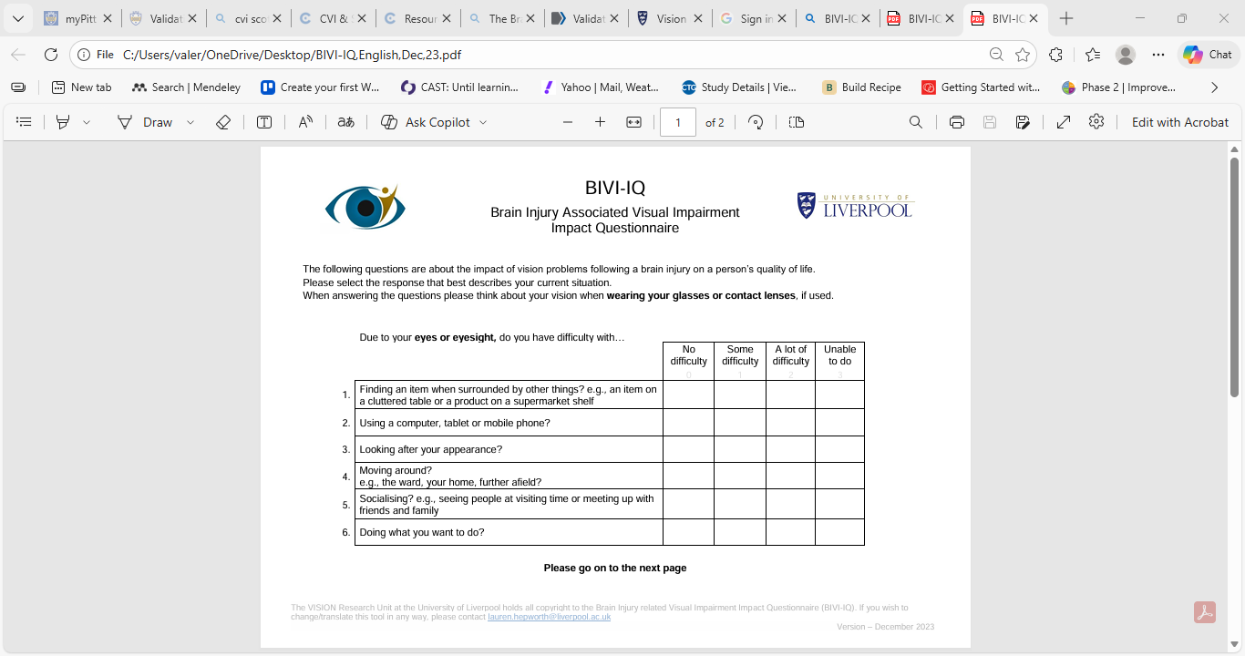
Tools for Assessment

Slide 52
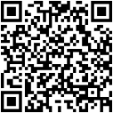

Slide 53
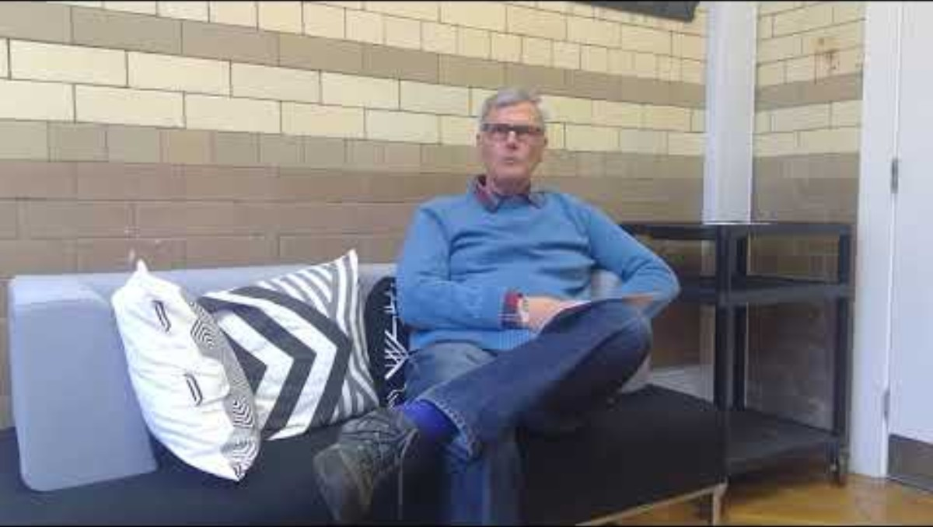

Slide 54
The Newcastle Adult CVI Inventory
This inventory, in your packet, is based on the Glasgow Pediatric CVI Inventory and is available on the CVI Scotland website as well
This inventory is 44 questions long and relates to different areas of vision. The answers to the questions are either yes or no
The inventory is ideal for any individual (adult) who has suffered a stroke, dementia, has a diagnosis of multiple sclerosis, infection of the brain, injury to the brain, or an adult with possible CVI

Slide 55
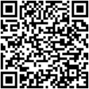

Slide 56
Activities of Daily Living (ADL)
Organize home with person
Have a set place of where things can be placed
Ensure doors are closed as well as kitchen cabinets
Different color cutting boards may be helpful for contrast
3D pens to mark items
Pots and pans with heat resistant handles
Liquid level indicator for pouring drinks

Slide 57
Questions or Thoughts?
My contact information:
Valery Kircher
Valery.kircher@dbvi.virginia.gov
Valery.kircher@gmail.com

Slide 58
Pelak, V. S. (2022). The clinical approach to the identification of higher-order visual dysfunction in neurodegenerative disease. Current Neurology and Neuroscience Reports, 22(4), 229–242. https://doi.org/10.1007/s11910-022-01186-7 ^{3,7,9}
Lammers NA, Van den Berg NS, Lugtmeijer S, Smits AR, Pinto Y, de Haan EHF,
(2022) Mid-range visual deficits after stroke: Prevalence and co-occurrence. PLoS ONE 17(4):e0262886. https://doi.org/10.1371/journal.pone.0262886¹
Ravenscroft, J. (2019). The Routledge handbook of visual impairment (1st ed.). Routledge. https://doi.org/10.4324/9781315111353 ⁵
Chang, M. Y., & Merabet, L. B. (2024). Special commentary: Cerebral/cortical visual impairment working definition a report from the national institutes of health cvi Workshop. Ophthalmology (Rochester, Minn.), 131(12), 1359–1365. https://doi.org/10.1016/j.ophtha.2024.09.017 ⁴

Slide 59
Kertesz, A. (2024). Anton, Balint, Charles Bonnet, and the Others: The ABC of Cerebral Visual Syndromes (A Historical Guide and an Update). Canadian Journal of Neurological Sciences, 51(2), 300–304. https://doi.org/10.1017/cjn.2023.246 ^{2,8}
Lehman, S. S., Yin, L., Chang, M. Y., Suh, D. W., Yoo, S., Dumitrescu, A., Fredrick, D., Gise, R., Strominger, M., Rubin, S. E., Kodsi, S. R., Bradford, G. E., Morse, C. L., Lambert, J., Riefe, J. G., Noritz, G., Agrawal, R., Bell, D., Foster, J. E. A., … Yeargin-Allsopp, M. (2024). Diagnosis and Care of Children With Cerebral/Cortical Visual Impairment: Clinical Report. Pediatrics (Evanston), 154(6), Article 2024068465. https://doi.org/10.1542/peds.2024-068465 ¹⁰
Individuals with Disabilities Education Act of 2004, POLICY MEMO: Eligibility Determinations for Children Suspected of Having a Visual Impairment under IDEA (May 22, 2017).https://sites.ed.gov/idea/idea-files/policy-memo-eligibility-determinations-for-children-suspected-of-having-a-visual-impairment-under-idea/ ¹¹

Slide 60
Rice, M. L., Schwartz, T. L., Bulman, J., Lin, L., & Harpster, K. (2025). Cerebral visual impairment (CVI) overlooked: A retrospective review of missed opportunities to diagnose CVI. Ophthalmic & Physiological Optics, 45(7), 1622–1629. https://doi.org/10.1111/opo.70017 ⁶
St Clair Tracy, H., McDowell, N., Dutton, G. N., Ravenscroft, J., Hay, I., & Blaikie, A. (2025). Emulation of the subjective experience of visual dorsal stream dysfunction: a description of three in depth case studies. Frontiers in Human Neuroscience, 18, 1496811. https://doi.org/10.3389/fnhum.2024.1496811 ^{12,13,22}
Veronelli, L., Daini, R., Gallucci, M., Toneatto, C., Pino, S., Ghielmi, L., & Primativo, S. (2025). Computerized Open-Source Navon Test (COSNaT): Normative data for the assessment of global processing abilities and simultanagnosia in the Italian population. Behavior Research Methods, 57(10), Article 284. https://doi.org/10.3758/s13428-025-02811-2 ¹⁴
Agraphia. (2018). In Encyclopedia of Clinical Neuropsychology.(pp.80-88)²³

Slide 61
Jakubowski, J. S., May, E., Findlay, R., McDowell, N., Simkin, S. K., & Hamm, L. M. (2025). ‘We don’t know nearly enough’: an online survey exploring perspectives of specialists who support children with brain-based visual impairments. Frontiers in Human Neuroscience, 18, 1510812. https://doi.org/10.3389/fnhum.2024.1510812 ¹⁵
Pelak, V. (year) Beyond Memory: Unraveling Posterior Cortical Atrophy Syndrome – A Visual Variant of Alzheimer’s Disease and Related Disorders. https://neurology.uw.edu/2025/10/30/beyond-memory-unraveling-posterior-cortical-atrophy-syndrome-a-visual-variant-of-alzheimers-disease-and-related-disorders/ ¹⁶
CVI Scotland () https://cviscotland.org/lessons.php?id=60 ¹⁷
Konopka, A. K., Kasprzyk, A., Pyttel, J., Chmielik, L. P., & Niedzielski, A. (2024). Etiology, diagnostic, and rehabilitative methods for children with central auditory processing disorders—a scoping review. Audiology Research (Pavia, Italy), 14(4), 736–746. https://doi.org/10.3390/audiolres14040062 ¹⁸

Slide 62
Barton, J. J. S., Duchaine, B., & Albonico, A.(2025). Imagery and perception in acquired prosopagnosia: Functional variants and their relation to structure. Cortex, 183, 330–348.https://doi.org/10.1016/j.cortex.2024.11.011 ¹⁹
McDowell, N., St Clair Tracy, H., Blaikie, A., Ravenscroft, J., & Dutton, G. N. (2024). Hiding in plain sight: children with visual perceptual difficulties in schools. Frontiers in Human Neuroscience, 18, 1496730. https://doi.org/10.3389/fnhum.2024.1496730 ²⁰
U.S. Department of Justice Civil Rights Division (February 28, 2020) Guide to Disability Rights Laws. Guide to Disability Rights Laws | ADA.gov ²¹
University of Liverpool (n.d.) Brain Injury associated Visual Impairment Questionnaire (BIVI-IQ) BIVI-IQ | Institute of Population Health | University of Liverpool
CVI Scotland (2026) Mainstream Secondary School Partnership Model. What is CVI? — CVI Scotland ²²

